Slide 1


Slide 2
SRE Presentation
Presented By
Jibran Naeem
Hamza Mehmood
BSSE-3
National University of Modern Languages

Slide 3

DRESS SHOP MANAGEMENT SYSTEM

Slide 4
Functional requirements
The CUSTOMER and SHOPKEEPER shall be able to register themself.
ADMIN ,customer and shopkeeper shall be able to login with his username and unique password.
Shopkeeper shall be able to manage products or record of all items.
The customer shall be able to view product and its price.
The customer shall be able to manage Cart ,Give Feedback and Place Order. .
Admin shall be able to see order details.
Customer shall be able to pay through credit card or debit card.
Admin shall be able to deliver order through courier.

Slide 5
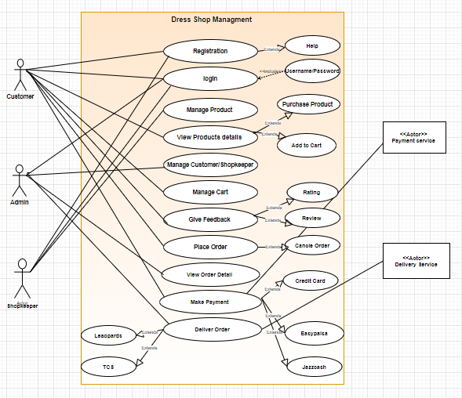
Use Case Diagram

Slide 6
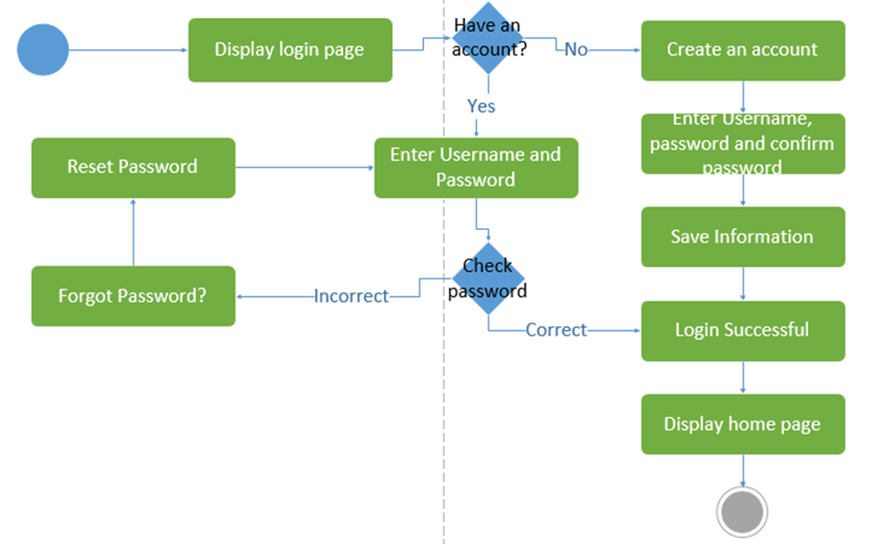
Activity Diagram For Login

Slide 7

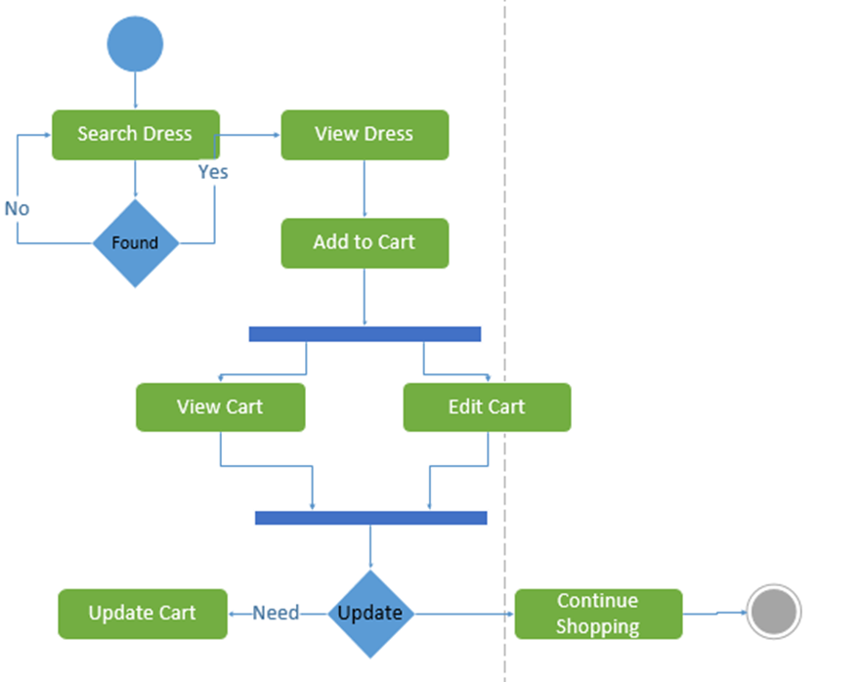
2. Activity Diagram For Manage Cart

Slide 8
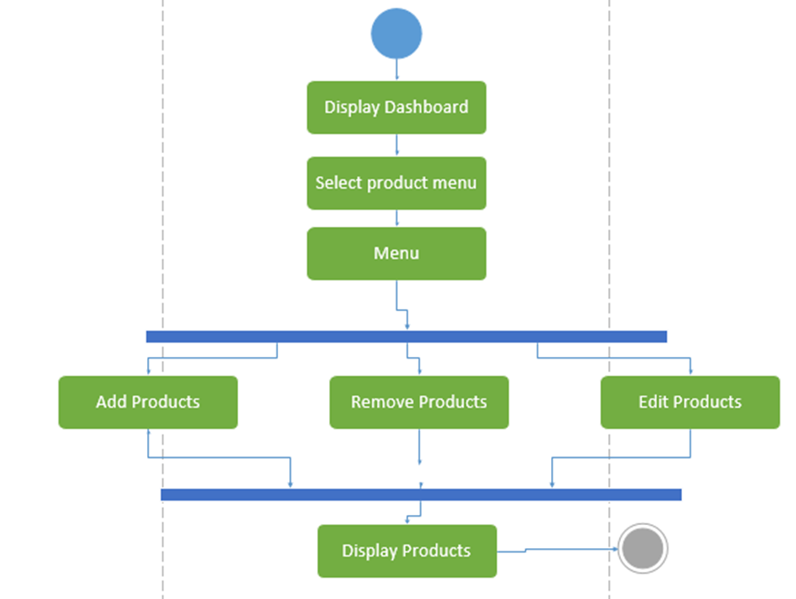

3. Activity Diagram For Manage Product

Slide 9
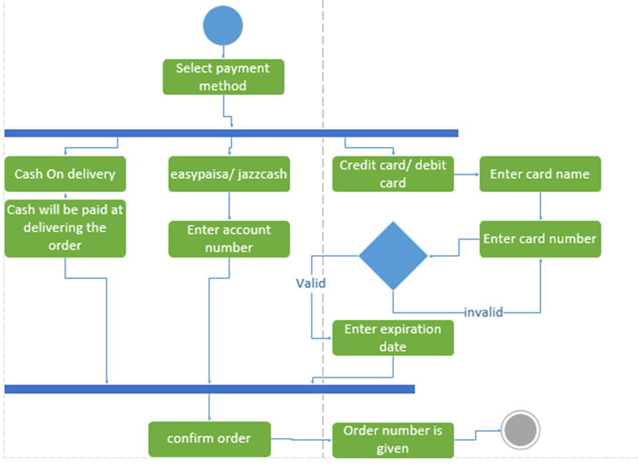
4. Activity Diagram For Make Payment

Slide 10
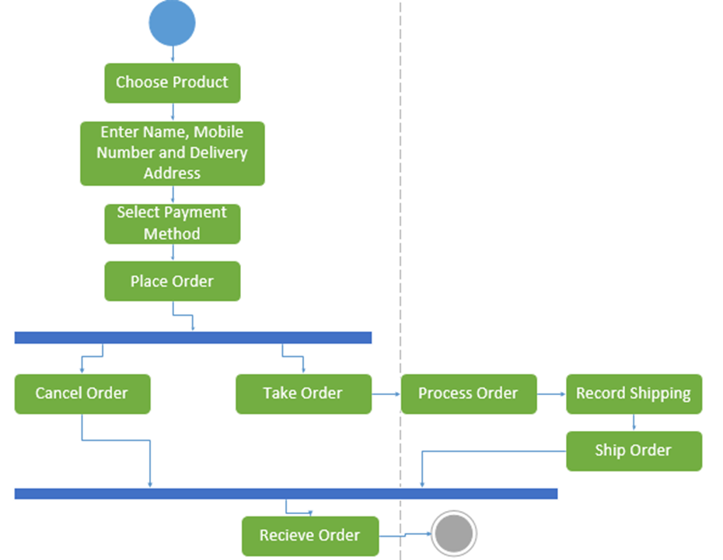
Activity Diagram For Place Order

Slide 11
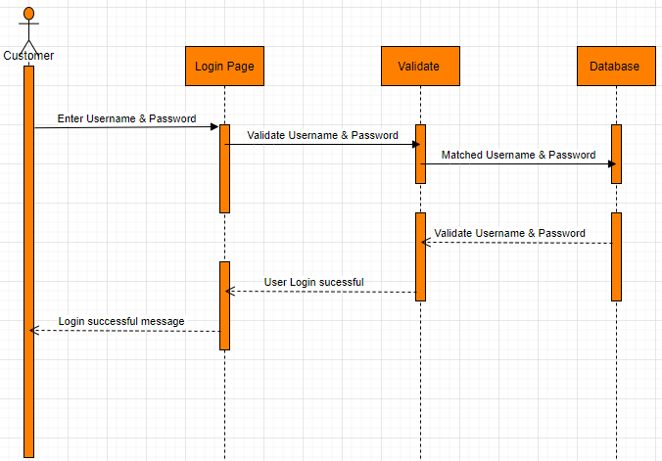
1. Sequences Diagram For Login

Slide 12
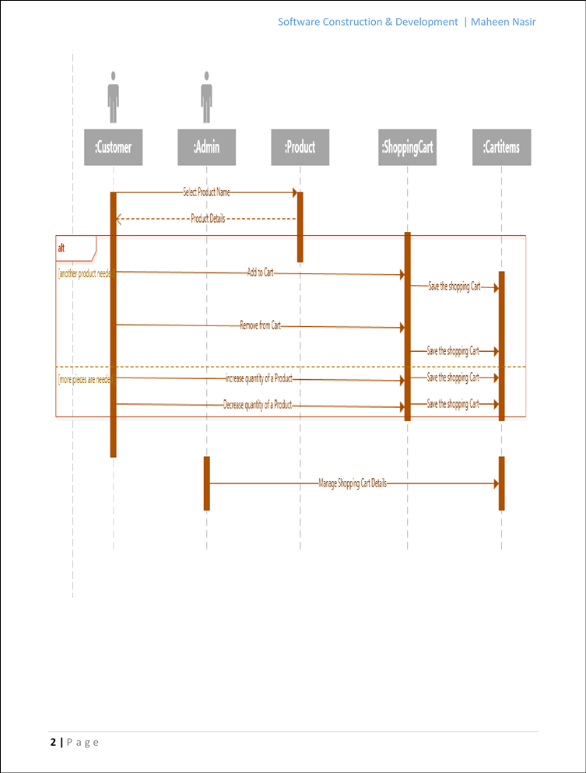
2. Sequences Diagram For Manage Cart

Slide 13
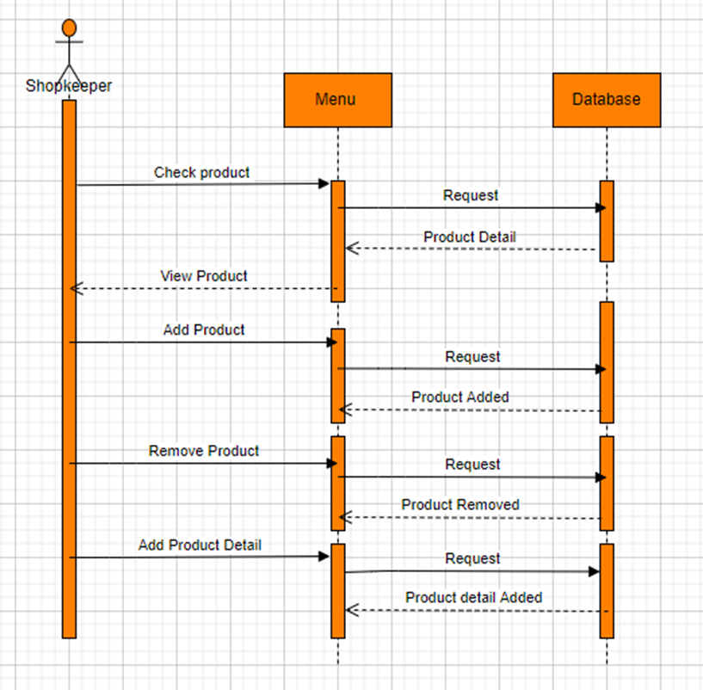
3. Sequences Diagram For Manage Product

Slide 14
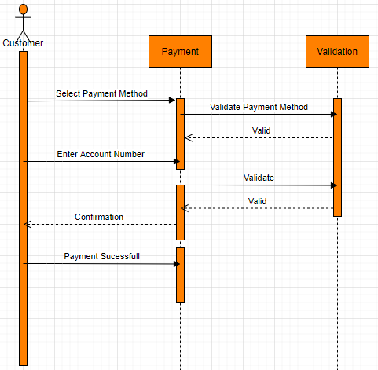
4. Sequences Diagram For Place Order

Slide 15


